Slide 1
BRAINWORKS Update
Dec 20th, 2022

Slide 2
What is BRAINWORKS? A tool to represent the literature, and it’s context, using dynamic knowledge graphs

Slide 3
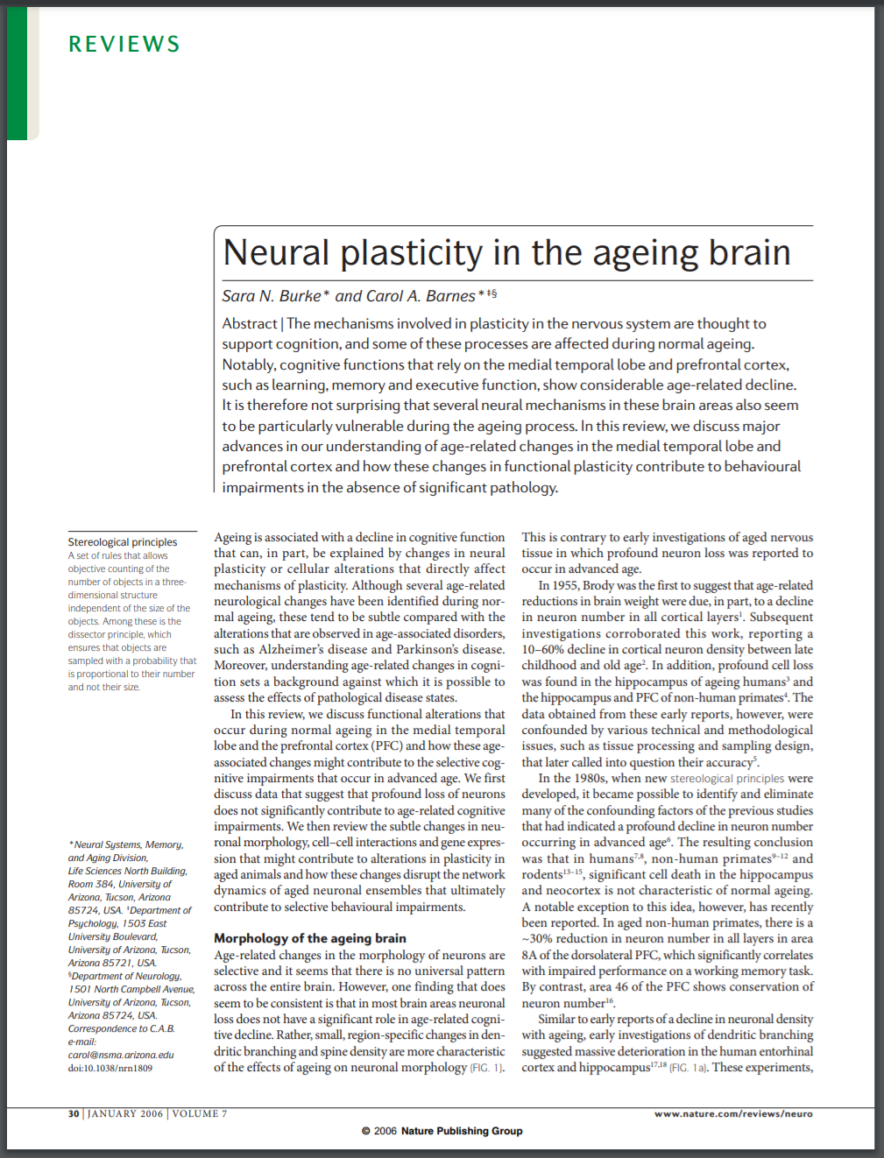
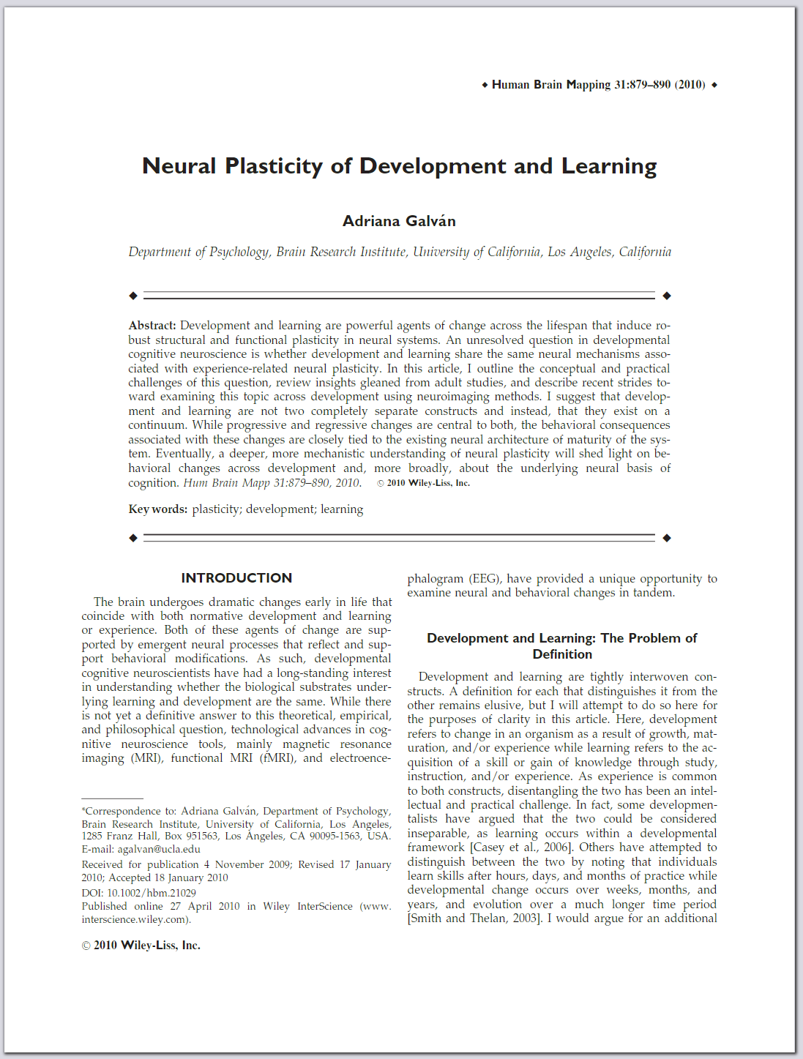
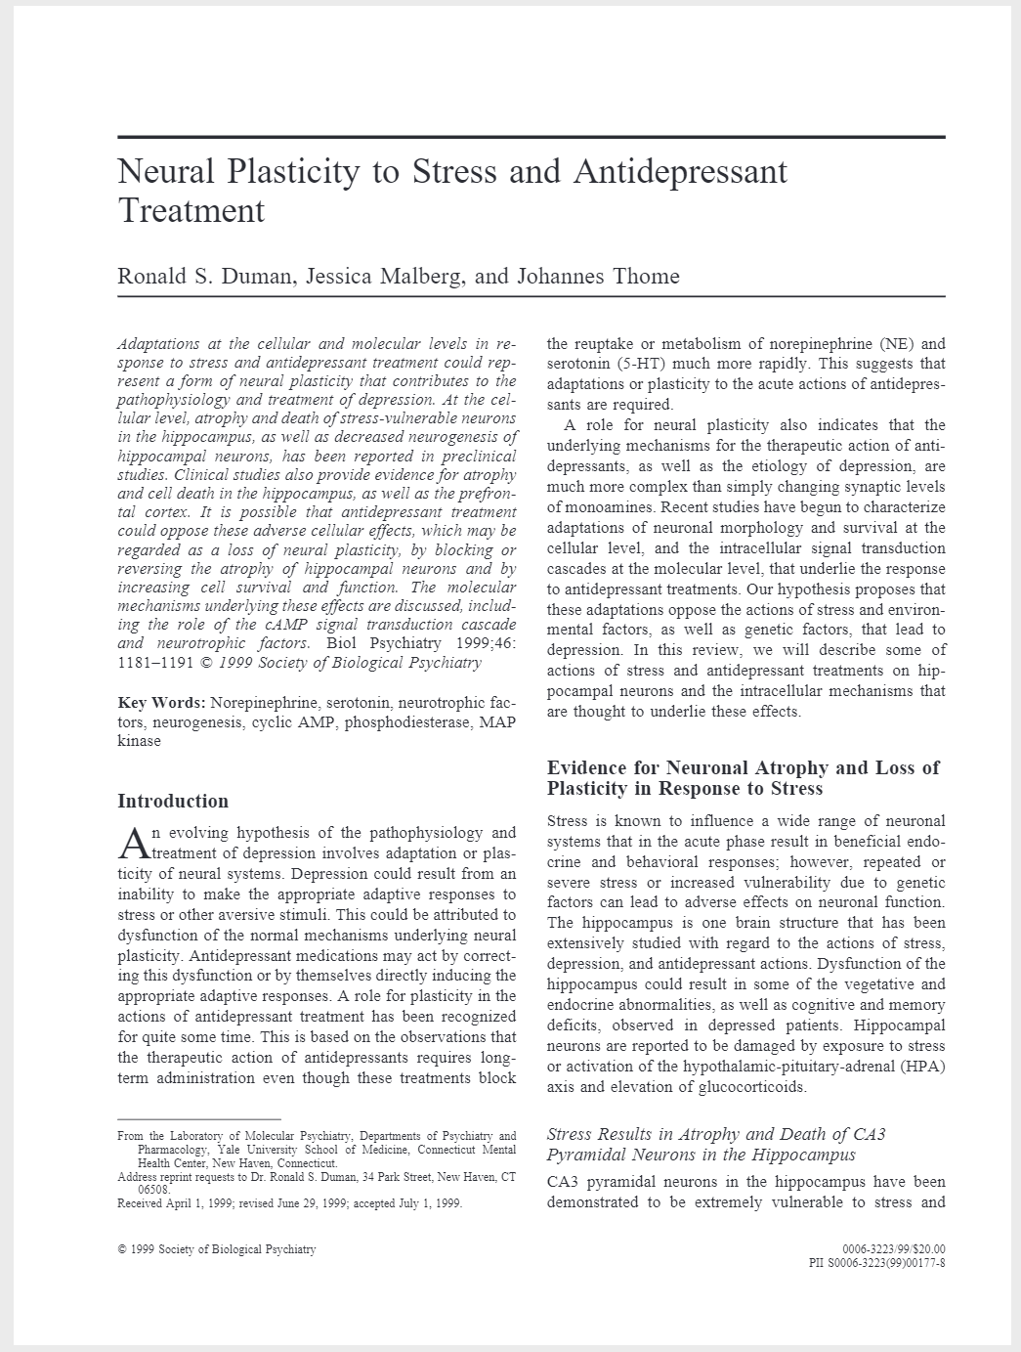
BRAINWORKS converts papers into a dynamic knowledge graph
Users control node/edge definitions and the temporal and semantic resolution of the graph
Notes:
Profound neuron loss is are characteristics of aging.

Slide 4
BRAINWORKS converts papers into a dynamic knowledge graph
Users control node/edge definitions and the temporal and semantic resolution of the graph
Dendritic branching
inhibits
Stress
Cognitive Ability
f(…)
impacts
f(…)
inhibits
f(…)
Age
Notes:
Age-related Depression may be caused by long term exposures to aversive stimuli, resulting in dysfunction of the normal mechanisms underlying neural plasticity, and consequent decline in cognitive abilities.

Slide 5
BRAINWORKS converts papers into a dynamic knowledge graph
Users control node/edge definitions and the temporal and semantic resolution of the graph
Cognitive Ability
inhibits
Age
t = 0

Slide 6
BRAINWORKS converts papers into a dynamic knowledge graph
Users control node/edge definitions and the temporal and semantic resolution of the graph
inhibits
Stress
Cognitive Ability
inhibits
Age
t = 1

Slide 7
1.1 Value measured by ability to predict future theory properties
BRAINWORKS converts papers into a dynamic knowledge graph
More specifically, the rate of propagation and change in the properties of theories across time
Users control node/edge definitions and the temporal and semantic resolution of the graph
inhibits
Stress
Cognitive Ability
impacts
Dendritic branching
inhibits
Age
t = 3

Slide 8
BRAINWORKS converts papers into a dynamic knowledge graph
Users control node/edge definitions and the temporal and semantic resolution of the graph
Dendritic branching
inhibits
Stress
Cognitive Ability
f(…)
impacts
f(…)
inhibits
f(…)
Age
t = 4

Slide 9
What has changed in the last year? We developed a functional web platform for BRAINWORKS, and several new visualization tools

Slide 10
2022 development activities focused on delivering a beta web platform
The 2021 development was a collection of algorithms and data collection scripts that served as a POC
BRAINWORKS Status 2021: A Reseach POC M. Ghassemi, Full Time Effort, DATA Scholar
BRAINWORKS Status 2022: A Web Application
A. Zitzelberger & M. Ghassemi, Half Time Effort, Ghamut
Research to demonstrate the ability to collect, synthesize and store publication and grant data. Analysis and visualization of the collected data for a variety of use-cases: impact of grants on collaborative structure, knowledge graphs to integrate findings in the literature, and visualizations to characterize trends in research topic interest.
Development of a web platform (and associated infrastructure) that integrates and extends the data, algorithms and visualizations developed in 2021. Unlike the POC, the platform enables the creation and management of user accounts, searching of data assets, and creation of interactive visualizations of the data collected by BRARINWORKS.

Slide 11
Notable accomplishments were mostly related to operationalization and Interactivity
Enhancements to Infrastructure, Data, Algorithms, and Visualizations were accomplished
Infrastructure
Analysis
Developed, tested and deployed a scalable, cost-effective system for the collection, storage and analysis of 40 years of publications and associated meta-data.
User data collected from BRAINWORKS to perform an ad-hoc analysis of the Team E portfolio in comparison to the other BRAIN Teams and CRCNS.
Algorithm
Visualization
Developed* a working definition for research “novelty” as well as preliminary algorithms to measure and predict it.
Developed four tools that allow users to explore: (1) citation networks, (2) semantic knowledge graphs, (3) research topic co-occurrences and (4) information extracted from individual publications.
* Work is ongoing

Slide 12
Notable accomplishments were mostly related to operationalization and Interactivity
Enhancements to Infrastructure, Data, Algorithms, and Visualizations were accomplished
Infrastructure
Analysis
Developed, tested and deployed a scalable, cost-effective system for the collection, storage and analysis of 40 years of publications and associated meta-data.
User data collected from BRAINWORKS to perform an ad-hoc analysis of the Team E portfolio in comparison to the other BRAIN Teams and CRCNS.
Algorithm
Visualization
Developed* a working definition for research “novelty” as well as preliminary algorithms to measure and predict it.
Developed four tools that allow users to explore: (1) citation networks, (2) semantic knowledge graphs, (3) research topic co-occurrences and (4) information extracted from individual publications.
* Work is ongoing

Slide 14
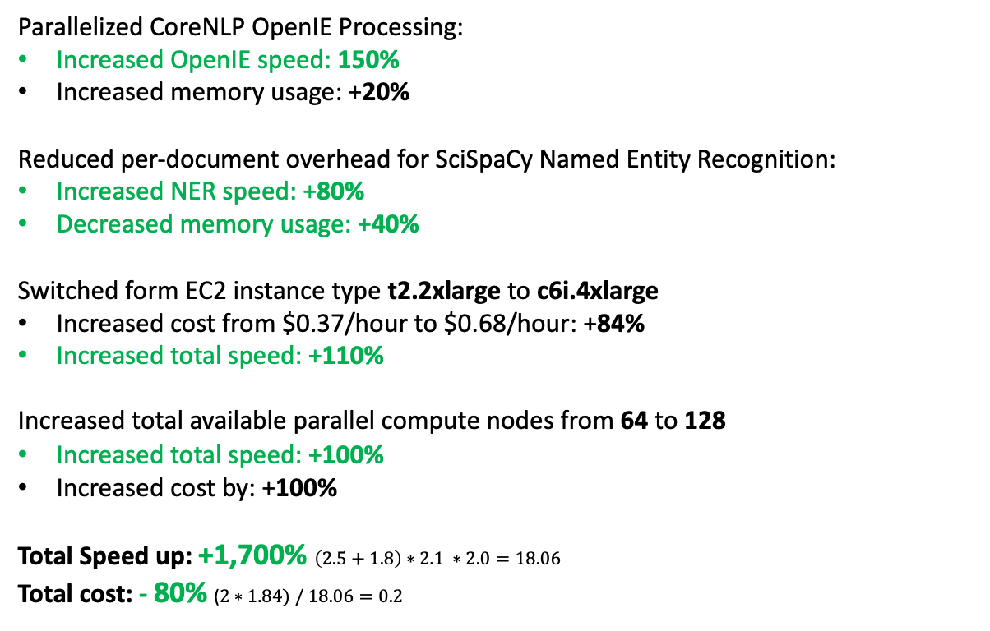
Optimized Information Extraction Pipeline
We have also greatly increased the efficiency of our machine-learning algorithms and infrastructure
Parallelized CoreNLP OpenIE Processing:
Increased OpenIE speed: 150%
Increased memory usage: +20%
Reduced per-document overhead for SciSpaCy Named Entity Recognition:
Increased NER speed: +80%
Decreased memory usage: +40%
Switched form EC2 instance type t2.2xlarge to c6i.4xlarge
Increased cost from $0.37/hour to $0.68/hour: +84%
Increased total speed: +110%
Increased total available parallel compute nodes from 64 to 128
Increased total speed: +100%
Increased cost by: +100%
Total Speed up: +1,700% $\left(2.5+1.8\right)∗2.1 ∗2.0=18.06$
Total cost: - 80% ($2∗1.84) / 18.06=0.2$
Estimated cost to run pipeline once:
Before: $60,000 over 200 hours
After: $2,400 over 40 hours

Slide 15
Notable accomplishments were mostly related to operationalization and Interactivity
Enhancements to Infrastructure, Data, Algorithms, and Visualizations were accomplished
Infrastructure
Analysis
Developed, tested and deployed a scalable, cost-effective system for the collection, storage and analysis of 40 years of publications and associated meta-data.
User data collected from BRAINWORKS to perform an ad-hoc analysis of the Team E portfolio in comparison to the other BRAIN Teams and CRCNS.
Algorithm
Visualization
Developed* a working definition for research “novelty” as well as preliminary algorithms to measure and predict it.
Developed four tools that allow users to explore: (1) citation networks, (2) semantic knowledge graphs, (3) research topic co-occurrences and (4) information extracted from individual publications.
* Work is ongoing

Slide 16
Notable accomplishments were mostly related to operationalization and Interactivity
Enhancements to Infrastructure, Data, Algorithms, and Visualizations were accomplished
Infrastructure
Analysis
Developed, tested and deployed a scalable, cost-effective system for the collection, storage and analysis of 40 years of publications and associated meta-data.
User data collected from BRAINWORKS to perform an ad-hoc analysis of the Team E portfolio in comparison to the other BRAIN Teams and CRCNS.
Algorithm
Visualization
Developed* a working definition for research “novelty” as well as preliminary algorithms to measure and predict it.
Developed four tools that allow users to explore: (1) citation networks, (2) semantic knowledge graphs, (3) research topic co-occurrences and (4) information extracted from individual publications.
* Work is ongoing

Slide 17
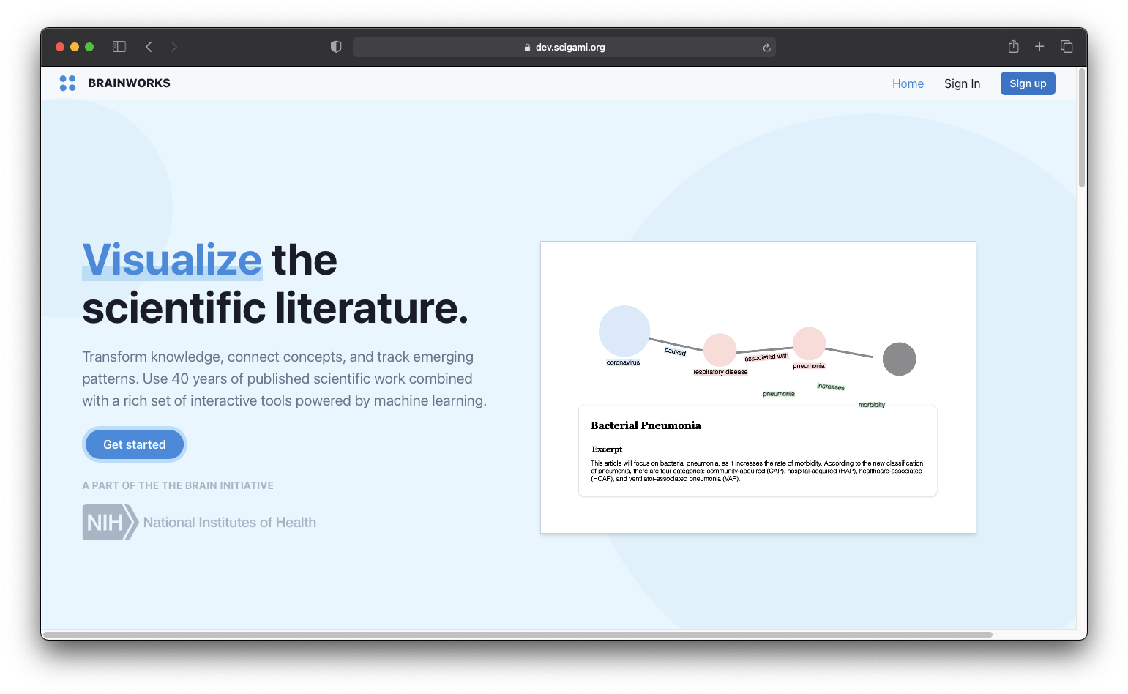

Slide 18
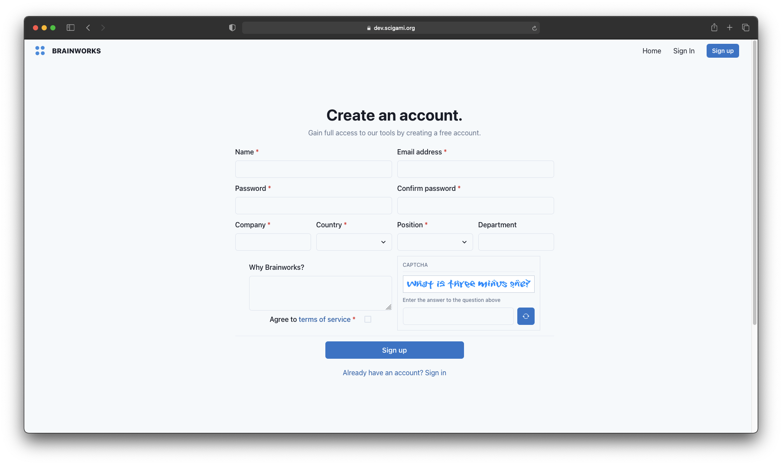

Slide 19
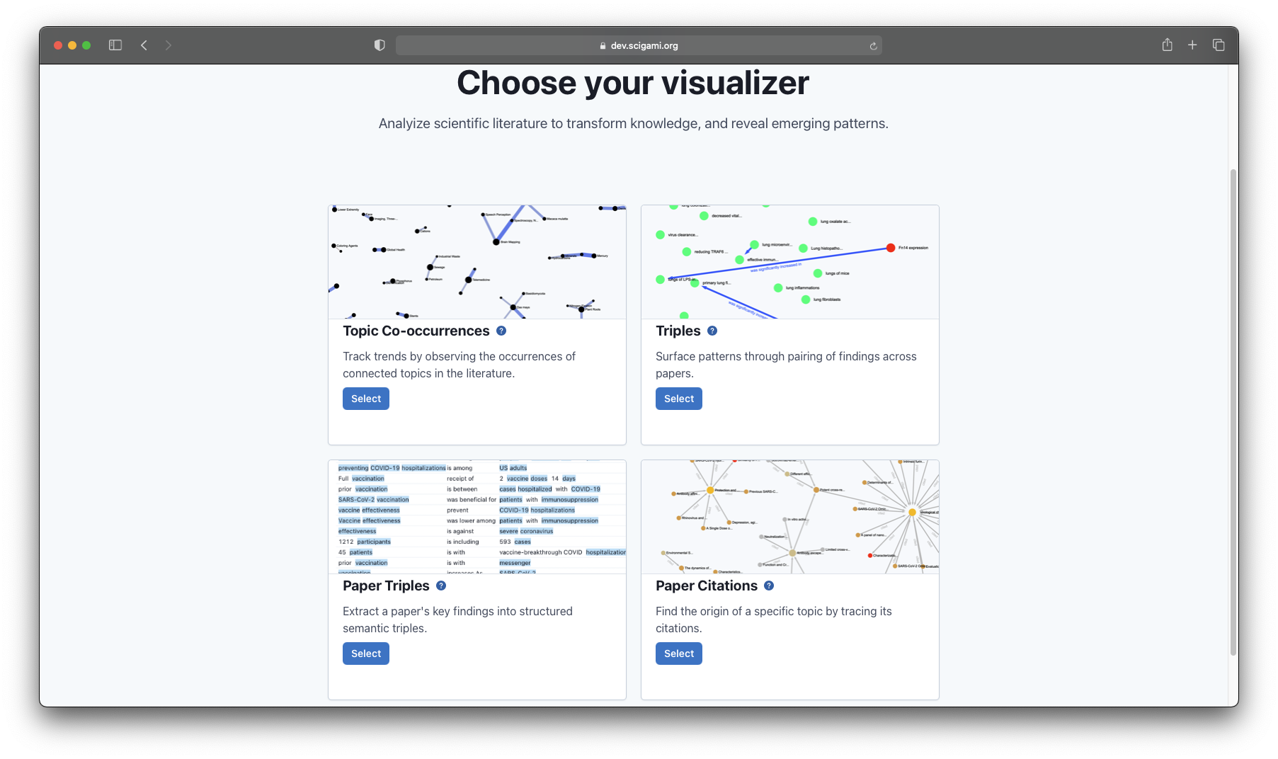

Slide 20
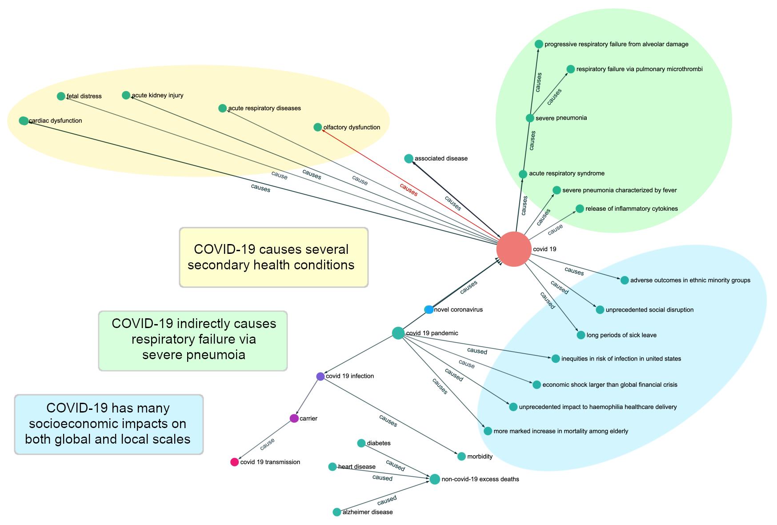

Slide 21
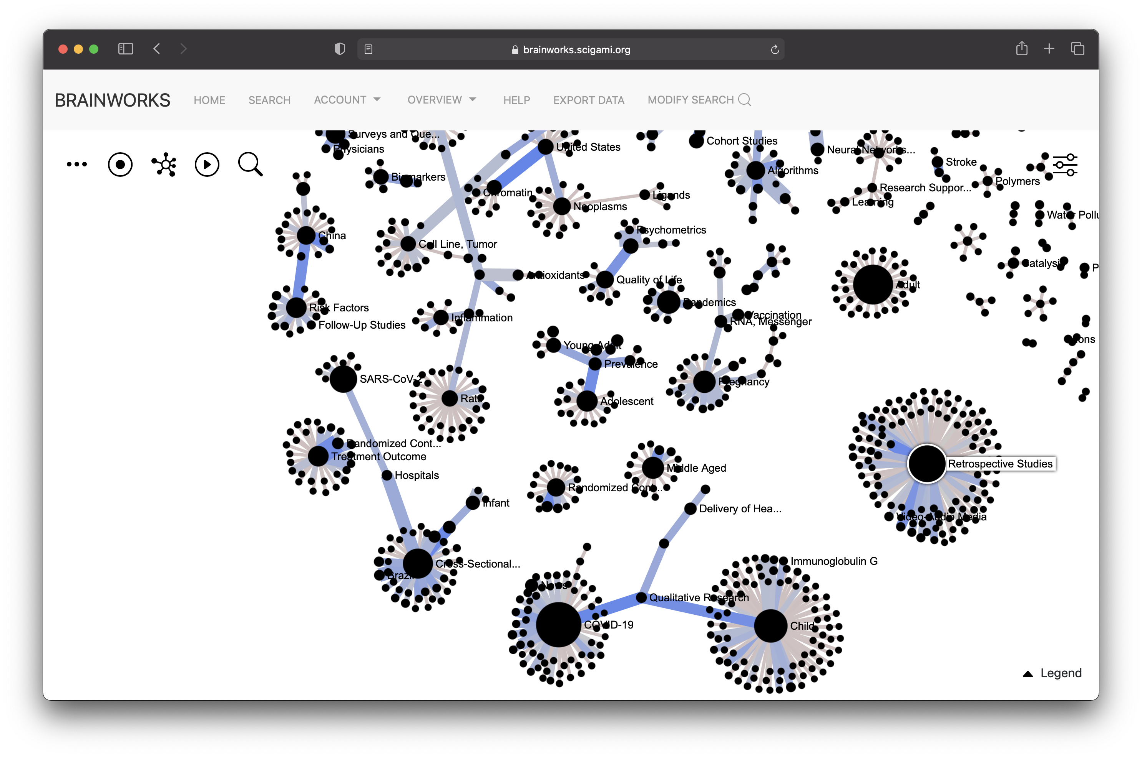

Slide 22
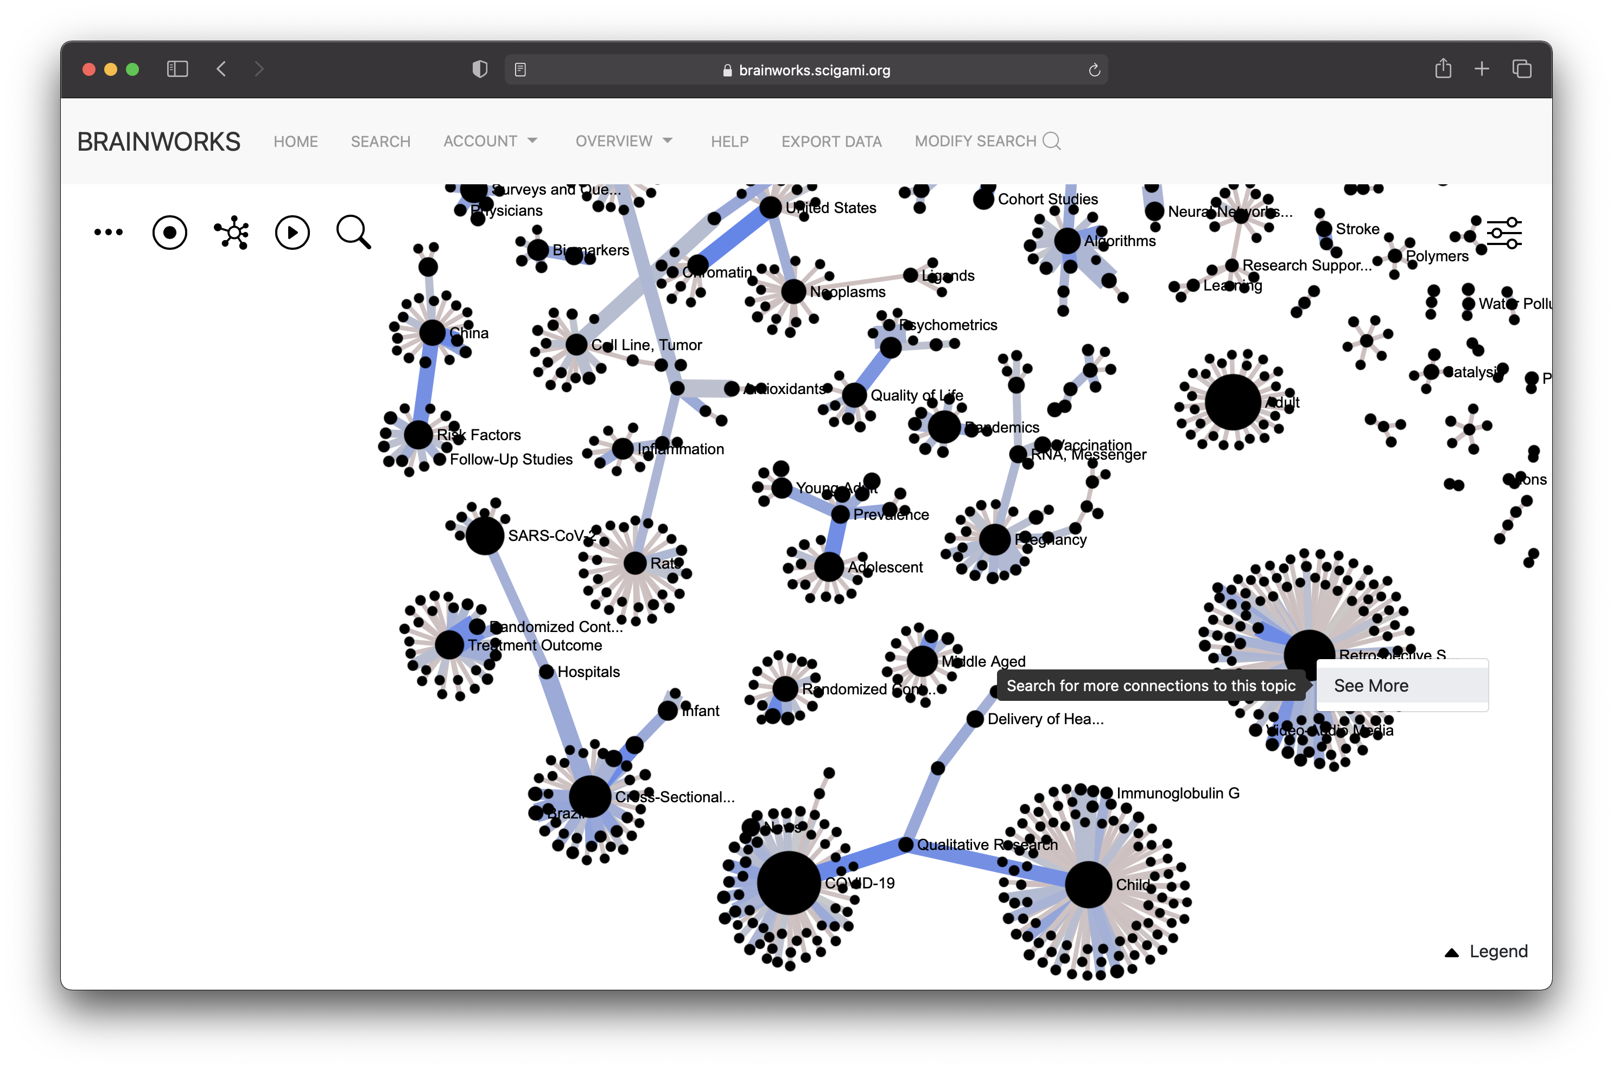

Slide 23
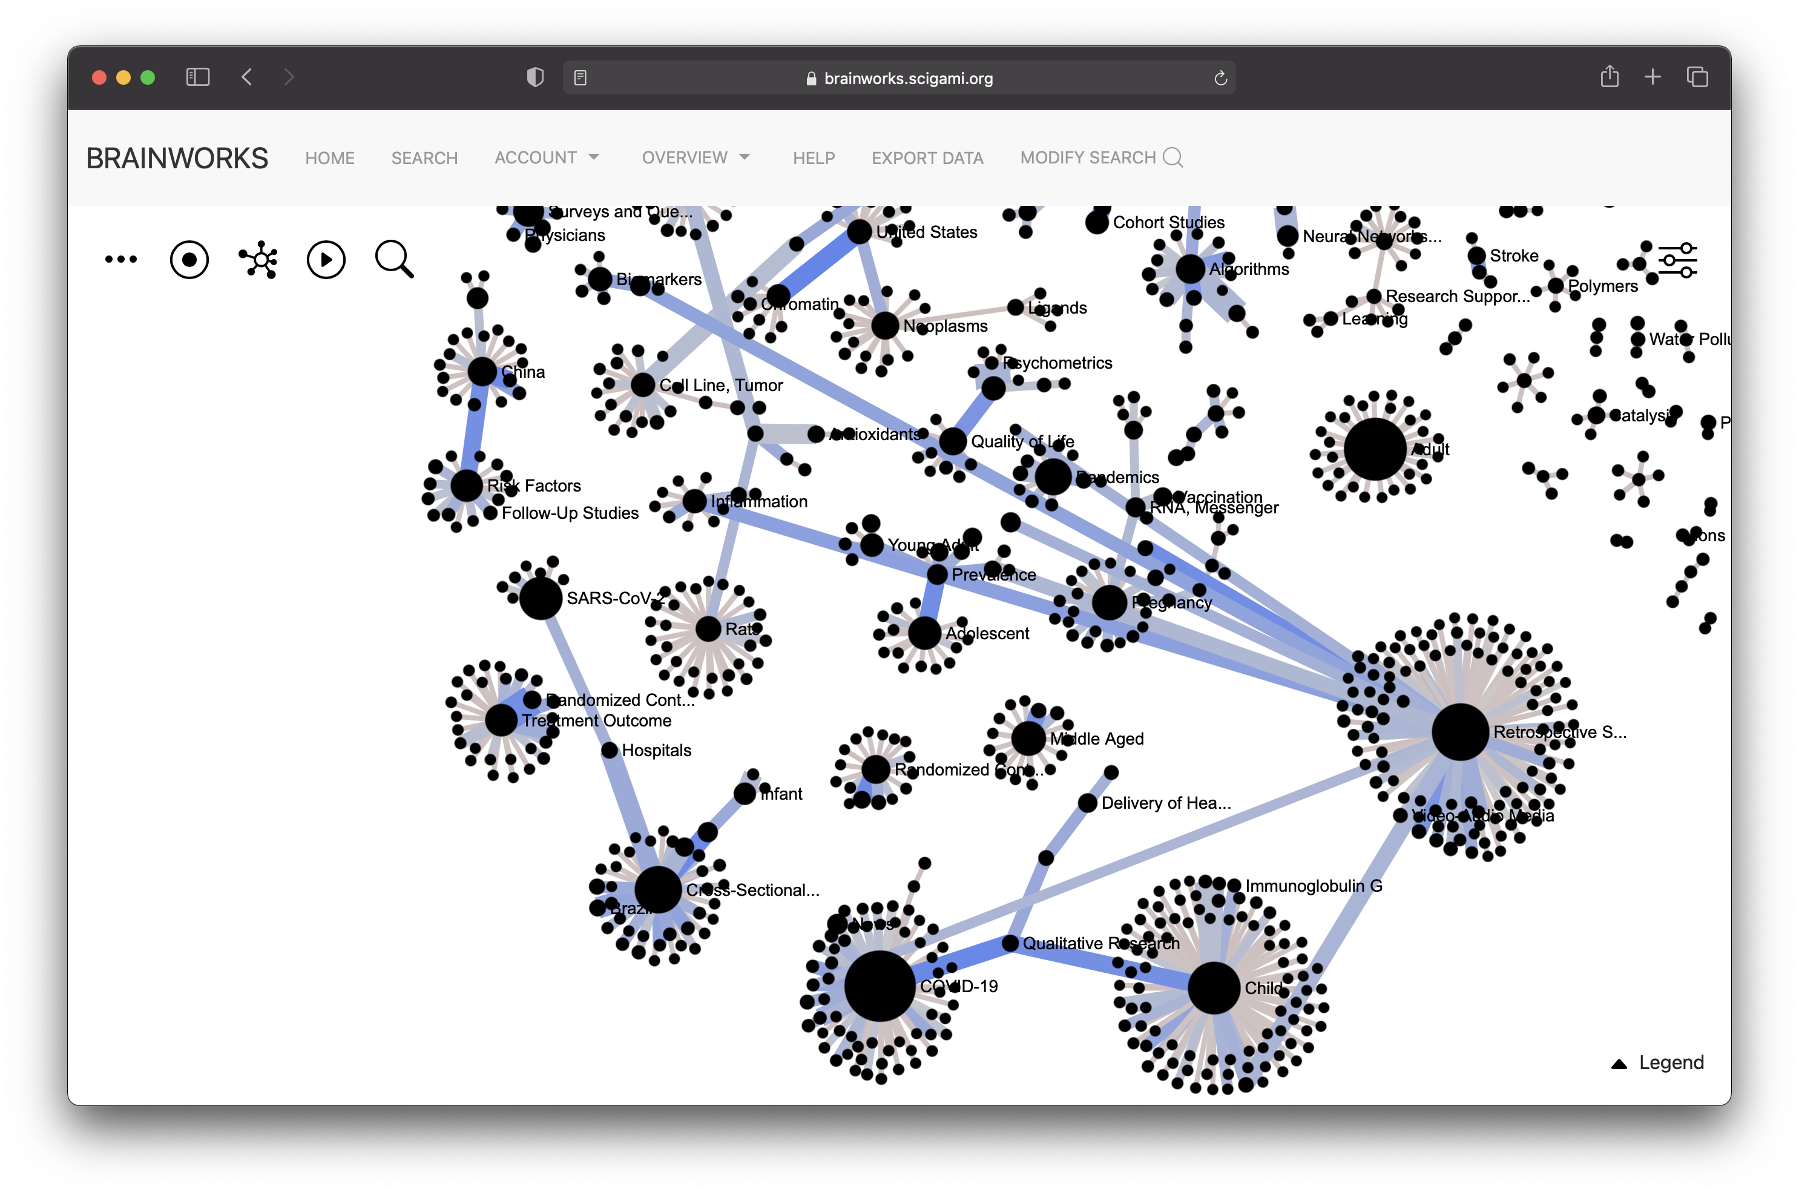

Slide 24
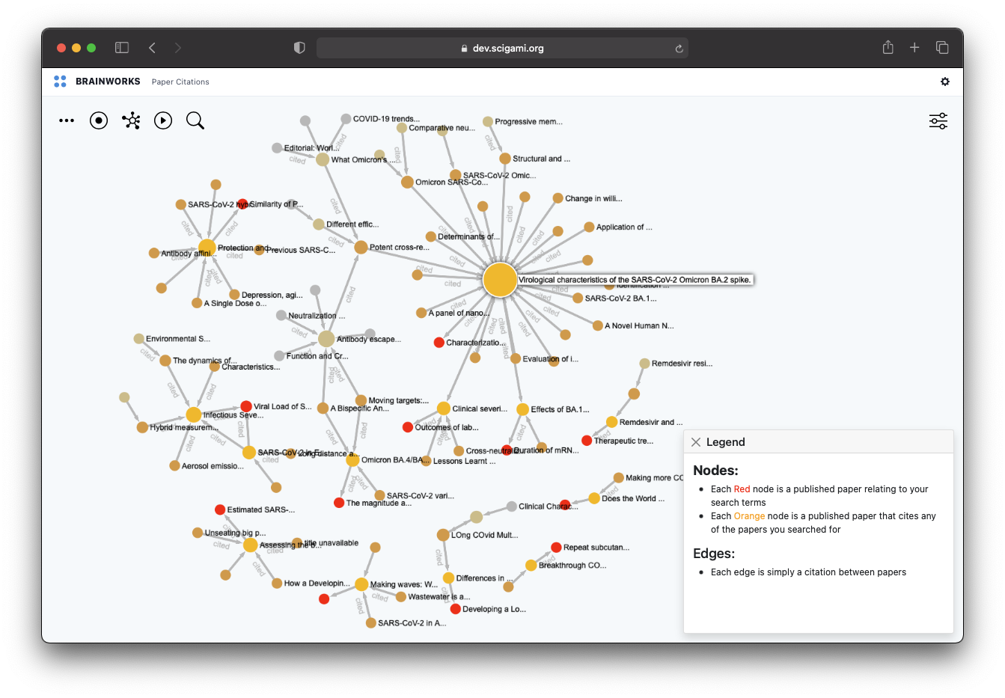

Slide 25
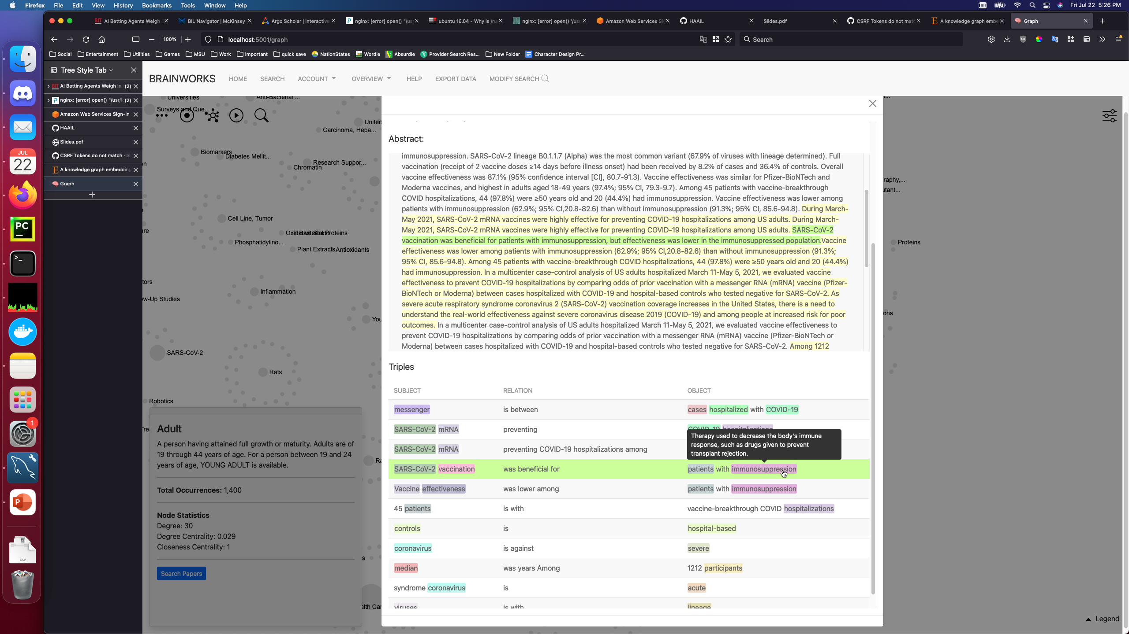
Individual Paper Info Page
View how our algorithms selects semantic triples from publication text
Origin sentence indicated
Highlighted topic words in subject and object
Topic definitions available on hover
Same topic is color-coded across triples

Slide 26
Notable accomplishments were mostly related to operationalization and Interactivity
Enhancements to Infrastructure, Data, Algorithms, and Visualizations were accomplished
Infrastructure
Analysis
Developed, tested and deployed a scalable, cost-effective system for the collection, storage and analysis of 40 years of publications and associated meta-data.
User data collected from BRAINWORKS to perform an ad-hoc analysis of the Team E portfolio in comparison to the other BRAIN Teams and CRCNS.
Algorithm
Visualization
Developed* a working definition for research “novelty” as well as preliminary algorithms to measure and predict it.
Developed four tools that allow users to explore: (1) citation networks, (2) semantic knowledge graphs, (3) research topic co-occurrences and (4) information extracted from individual publications.
* Work is ongoing

Slide 27
Notable accomplishments were mostly related to operationalization and Interactivity
Enhancements to Infrastructure, Data, Algorithms, and Visualizations were accomplished
Infrastructure
Analysis
Developed, tested and deployed a scalable, cost-effective system for the collection, storage and analysis of 40 years of publications and associated meta-data.
User data collected from BRAINWORKS to perform an ad-hoc analysis of the Team E portfolio in comparison to the other BRAIN Teams and CRCNS.
Algorithm
Visualization
Developed* a working definition for research “novelty” as well as preliminary algorithms to measure and predict it.
Developed four tools that allow users to explore: (1) citation networks, (2) semantic knowledge graphs, (3) research topic co-occurrences and (4) information extracted from individual publications.
* Work is ongoing

Slide 28
We would like BRAINWORKS to help us identify and predict scientific breakthroughs
This would allow us to filter semantic triples by their importance, and create more sparse graphs.

Slide 29
We would like BRAINWORKS to help us identify and predict scientific breakthroughs
This would allow us to filter semantic triples by their importance, and create more sparse graphs.
Breakthrough results
Notes:
Text 2 graph to text

Slide 30
We would like BRAINWORKS to help us identify and predict scientific breakthroughs
This would allow us to filter semantic triples by their importance, and create more sparse graphs.
Categories of Publications
What makes research novel?
Research is novel when it studies rare topics, or rare topic co-occurrences within science generally, or within a particular sub-domain of science.
How do we measure research impact?
Research impact is measured via citations or metrics that are a derivative of citations (APT, RCR, etc.)
What is a Breakthrough?
A breakthrough is a paper that occurred at an inflection point of research interest (i.e. after the paper, the topic or topic co-co-occurrence became much more pronounced than it was before.) and the paper is highly cited by future works involving the same topics.
Advancement
Breakthrough
High impact
Pittenger,et al. "Stress, depression, and neuroplasticity: a convergence of mechanisms." Neuropsychopharmacology 33.1 (2008): 88-109.
Jinek, Martin, et al. "A programmable dual-RNA–guided DNA endonuclease in adaptive bacterial immunity." Science 337.6096 (2012): 816-821.
2,016 citations
14,949 citations
Finding
Discovery
Incremental Impact
Szumlinski, Karen K., et al. "Homer2 is necessary for EtOH-induced neuroplasticity." Journal of Neuroscience 25.30 (2005): 7054-7061.
Stoddard, Mary Caswell, et al. "Avian egg shape: Form, function, and evolution." Science 356.6344 (2017): 1249-1254
166 citations
160 citations
Incremental Novelty
High Novelty

Slide 31

We would like BRAINWORKS to help us identify and predict scientific breakthroughs
This would allow us to filter semantic triples by their importance, and create more sparse graphs.
low impact low novelty
low impact high novelty
Scientific Activity
On Topic intersection
High impact
Low novelty
Impact ?
Novelty ?
High impact
High novelty
Time

Slide 32
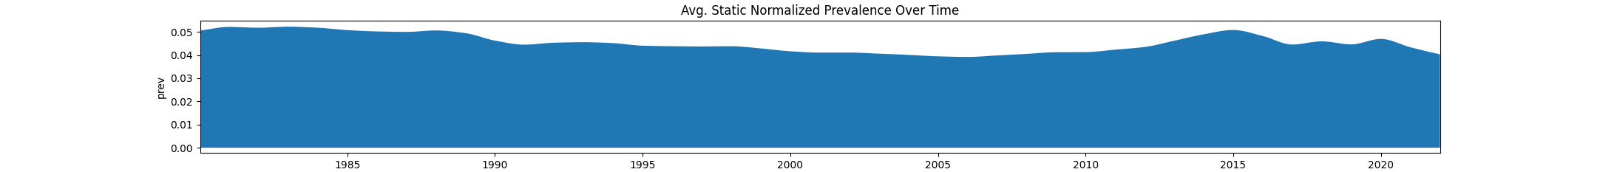
We have extracted core statistics from all papers for novelty metric creation
Current iteration – Using statistical measures and a short-range time window for temporal analysis
For every potential topic pair, we use 7 core statistics
|S|
Total pair occurrences
|A|
Total Topic-A occurrences
|B|
Total Topic-B occurrences
| A ⋂ B |
Total occurrences of A intersect B
| A ⋃ B |
Total occurrences of A union B
P(A|B)
Probability of A given B
P(B|A)
Probability of B given A
Each statistic is taken over 5 time periods
All records before
All records after
5 years before
5 years after
The month of publication
From the stats, the following measures are gathered
Static Probability
Monthly Pair Probability
5-Year Temporal Probability
5 year After-Before probability ratio
Temporal Probability
After-Before Probability Ratio

Slide 33
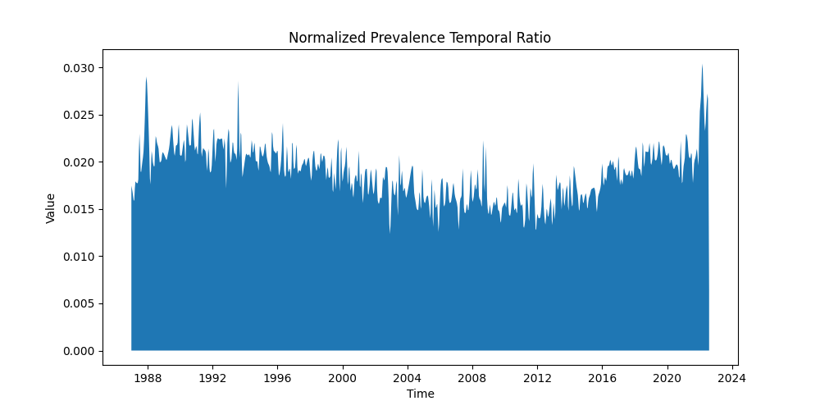
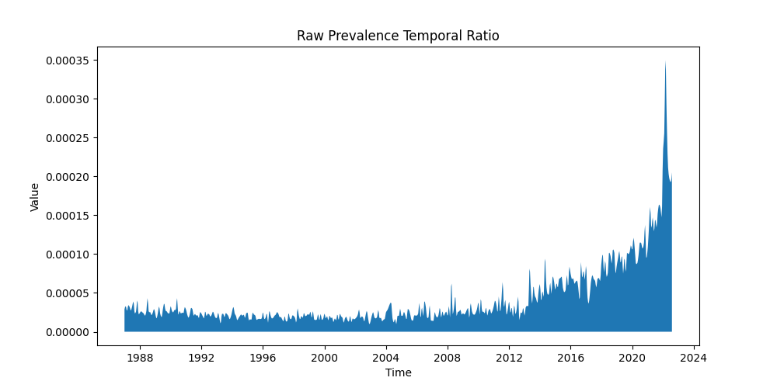
Example: History of publications related to CRISPR
Provides first order validation that our method may be able to identify novel papers
First hints of (what are now known as) CRISPRS found in E. coli
Ishino Y et al.
H Shinagawa et al.
Shown here are examples of two metrics produced for a subset of papers containing multiple co-occurrences of concepts related to CRISPR (Cas9 endonuclease, E. coli, gene knockout, gene targeting, repetitive sequence, etc.)
The difference between Raw and Normalized Prevalence is that Normalized Prevalence is normalized with respect to the frequency of each individual topic within a given pair.
As a result, the Raw Prevalence appears to provide a better perspective for the evolution of a field over time, whereas Normalized Prevalence provides insight into key moments in time.
CRISPRS observed for the first time in archaea
F. J. Mojica et al.
Demonstration of CRISPR mechanism
S. J. Brouns et al.
Programmable CRISPR Jinek, Martin, et al.
Use of CRISPR in animals becomes heavily investigated
Ex: J. M. Uribe-Salazar et al.

Slide 34
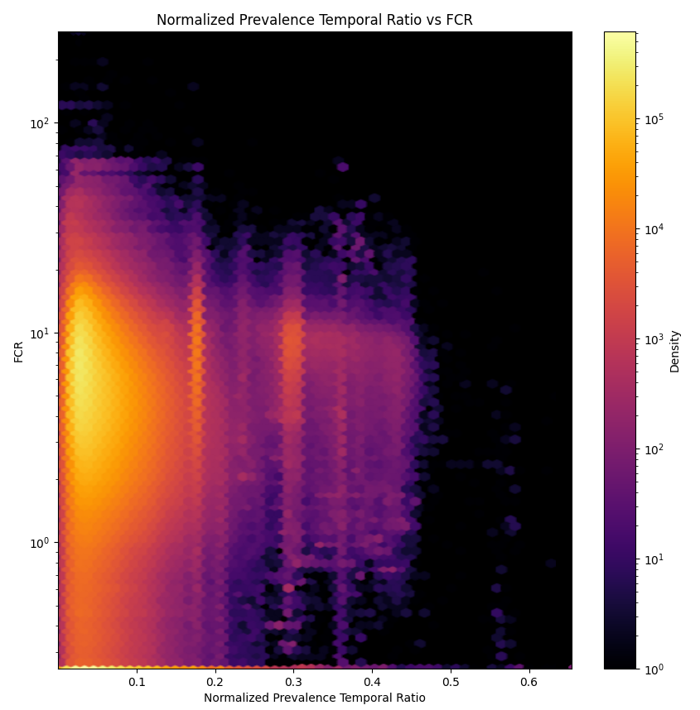
We would like BRAINWORKS to help us identify and predict scientific breakthroughs
Here is one possible set of impact and novelty metrics, with corresponding Team E examples
Non-neuronal expression of SARS-CoV-2 entry genes in the olfactory system suggests mechanisms underlying COVID-19-associated anosmia
D.H. Brann et al. 10.1126/sciadv.abc5801
“Findings” / “Advancements”
fMRIPrep: a robust preprocessing pipeline for functional MRI
O. Esteban et al. 10.1038/s41592-018-0235-4
“Breakthroughs”
Birds of a different feather sing together
A. Williams et al. 10.1038/s41593-019-0485-1
Hybrid High-order Functional Connectivity Networks Using Resting-state Functional MRI for Mild Cognitive Impairment Diagnosis
Y. Zhang et al. 10.1038/s41598-017-06509-0
“Discoveries”
Postictal clinical and electroencephalographic activity following intracranially recorded bilateral tonic-clonic seizures
L.M. Bateman et al. 10.1111/epi.14621

Slide 35
We would like BRAINWORKS to help us identify and predict scientific breakthroughs
Here is one possible set of impact and novelty metrics, with corresponding Team E examples
Non-neuronal expression of SARS-CoV-2 entry genes in the olfactory system suggests mechanisms underlying COVID-19-associated anosmia
D.H. Brann et al. 10.1126/sciadv.abc5801
“Findings” / “Advancements”
fMRIPrep: a robust preprocessing pipeline for functional MRI
O. Esteban et al. 10.1038/s41592-018-0235-4
“Breakthroughs”
Birds of a different feather sing together
A. Williams et al. 10.1038/s41593-019-0485-1
Hybrid High-order Functional Connectivity Networks Using Resting-state Functional MRI for Mild Cognitive Impairment Diagnosis
Y. Zhang et al. 10.1038/s41598-017-06509-0
“Discoveries”
Postictal clinical and electroencephalographic activity following intracranially recorded bilateral tonic-clonic seizures
L.M. Bateman et al. 10.1111/epi.14621

Slide 36
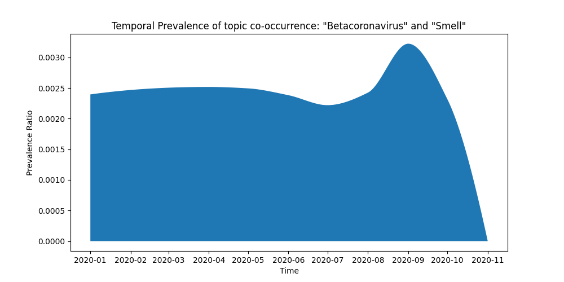
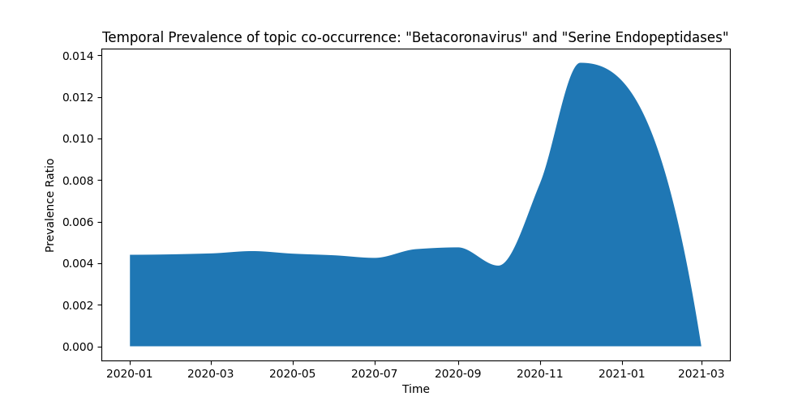
We would like BRAINWORKS to help us identify and predict scientific breakthroughs
We can see how our algorithm highly rated publications at the beginning of a spike in prevalence
Non-neuronal expression of SARS-CoV-2 entry genes in the olfactory system suggests mechanisms underlying COVID-19-associated anosmia
D.H. Brann et al. 10.1126/sciadv.abc5801

Slide 37
We would like BRAINWORKS to help us identify and predict scientific breakthroughs
Here is one possible set of impact and novelty metrics, with corresponding Team E examples
Non-neuronal expression of SARS-CoV-2 entry genes in the olfactory system suggests mechanisms underlying COVID-19-associated anosmia
D.H. Brann et al. 10.1126/sciadv.abc5801
“Findings” / “Advancements”
fMRIPrep: a robust preprocessing pipeline for functional MRI
O. Esteban et al. 10.1038/s41592-018-0235-4
“Breakthroughs”
Birds of a different feather sing together
A. Williams et al. 10.1038/s41593-019-0485-1
Hybrid High-order Functional Connectivity Networks Using Resting-state Functional MRI for Mild Cognitive Impairment Diagnosis
Y. Zhang et al. 10.1038/s41598-017-06509-0
“Discoveries”
Postictal clinical and electroencephalographic activity following intracranially recorded bilateral tonic-clonic seizures
L.M. Bateman et al. 10.1111/epi.14621

Slide 38
We would like BRAINWORKS to help us identify and predict scientific breakthroughs
Here is one possible set of impact and novelty metrics, with corresponding Team E examples
Non-neuronal expression of SARS-CoV-2 entry genes in the olfactory system suggests mechanisms underlying COVID-19-associated anosmia
D.H. Brann et al. 10.1126/sciadv.abc5801
“Findings” / “Advancements”
fMRIPrep: a robust preprocessing pipeline for functional MRI
O. Esteban et al. 10.1038/s41592-018-0235-4
“Breakthroughs”
Birds of a different feather sing together
A. Williams et al. 10.1038/s41593-019-0485-1
Hybrid High-order Functional Connectivity Networks Using Resting-state Functional MRI for Mild Cognitive Impairment Diagnosis
Y. Zhang et al. 10.1038/s41598-017-06509-0
“Discoveries”
Postictal clinical and electroencephalographic activity following intracranially recorded bilateral tonic-clonic seizures
L.M. Bateman et al. 10.1111/epi.14621

Slide 39
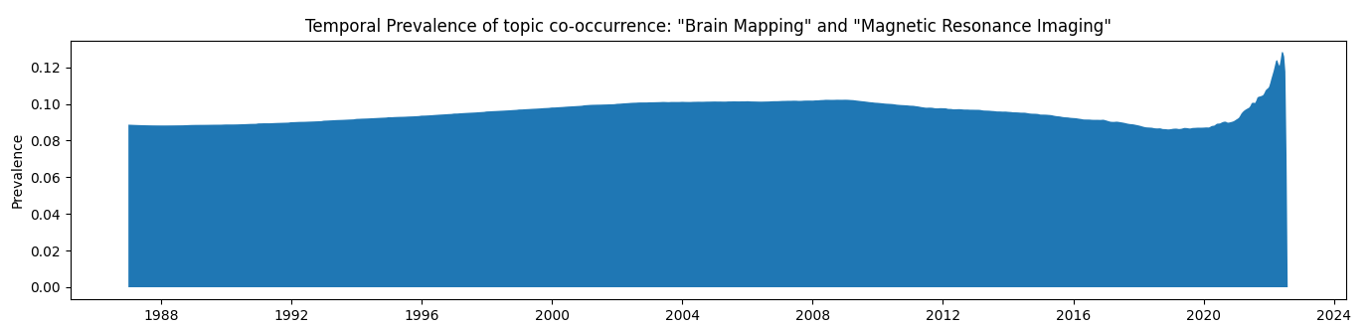
We would like BRAINWORKS to help us identify and predict scientific breakthroughs
We can see how our algorithm highly rated publications at the beginning of a spike in prevalence
fMRIPrep: a robust preprocessing pipeline for functional MRI
O. Esteban et al. 10.1038/s41592-018-0235-4
Time

Slide 40
Predict the Impact and Novelty of a paper, at the time of it’s publication
This next iteration would allow us to filter semantic triples by their importance, and create more sparse graphs.
1. Inputs are paper and author characteristics that are measured at or before the time of the publication
2. Model uses inputs to predict a impact adjusted measure of novelty
3. Target is continuous value at the measuring combination of novelty and impact.
Model Inputs:
Document embedding
Topics
Authors
Journal
Funding Information
Meta-data
LightGBM Model
10-fold cross-validation
0
dot
product
1.3
times
0
2.1
x
2.0
1
Impact adjustment
0.5
topic vector
Change in Prevalence
Pre-Publication Period
Publication period
Post-Publication period
Near Publication period
T - 5
years
T – 1
year
T + 1
year
T + 5
years
T = 0
Publication Date

Slide 41
Notable accomplishments were mostly related to operationalization and Interactivity
Enhancements to Infrastructure, Data, Algorithms, and Visualizations were accomplished
Infrastructure
Analysis
Developed, tested and deployed a scalable, cost-effective system for the collection, storage and analysis of 40 years of publications and associated meta-data.
User data collected from BRAINWORKS to perform an ad-hoc analysis of the Team E portfolio in comparison to the other BRAIN Teams and CRCNS.
Algorithm
Visualization
Developed* a working definition for research “novelty” as well as preliminary algorithms to measure and predict it.
Developed four tools that allow users to explore: (1) citation networks, (2) semantic knowledge graphs, (3) research topic co-occurrences and (4) information extracted from individual publications.
* Work is ongoing

Slide 42
Notable accomplishments were mostly related to operationalization and Interactivity
Enhancements to Infrastructure, Data, Algorithms, and Visualizations were accomplished
Infrastructure
Analysis
Developed, tested and deployed a scalable, cost-effective system for the collection, storage and analysis of 40 years of publications and associated meta-data.
User data collected from BRAINWORKS to perform an ad-hoc analysis of the Team E portfolio in comparison to the other BRAIN Teams and CRCNS.
Algorithm
Visualization
Developed* a working definition for research “novelty” as well as preliminary algorithms to measure and predict it.
Developed four tools that allow users to explore: (1) citation networks, (2) semantic knowledge graphs, (3) research topic co-occurrences and (4) information extracted from individual publications.
* Work is ongoing

Slide 43
Overview and Conclusions from BRAINWORKS Review of Team E, CRCNS, and OBSSR
A synopsis of our portfolio analysis
We have performed a longitudinal analysis on the publication portfolios of Team E compared to a total of 8 different reference groups:
1 – 7: BRAIN Initiative Teams A, B, C, D, N, Data, and TIE
8: Awardees of the Collaborative Research in Computational Neuroscience (CRCNS)
9: Office of Behavioral and Social Sciences Research (OBSSR)
Team A
Team B
Team C
Team D
The goal of this analysis was to understand how well Team E performed against these groups across multiple domains of scientific study, taking into account a wide range of factors to measure publication influence and lasting impact.
The results of this study lead to the conclusion that Team E leads the BRAIN Initiative in both volume and cost-efficiency of publications. Compared to CRCNS, Team E publications are better recognized in their field for every domain analyzed.
Our Team E analysis was performed over a total of 1,440 projects over 27 FOAs since 2014.
All other BRAIN teams combined totaled 2,150 projects over 89 FOAs. CRCNS comprised 603 projects over 42 FOAs, and OBSSR had about 43,000 projects over 4,060 FOAs.
Team E
Team N
Team Data
Team TIE
CRCNS
OBSSR

Slide 44
High-Level Simplification of our Collection Pipeline
NIH Spending categories are mapped to publications through their funding projects
PMIDs
Study Groups
31523449
34127459
35231315
35060534
.
.
.
.
.
.
.
.
37803434
31234586
33932935
32449269
NIH Spending Categories
Core Project Numbers
Team A
Behavior & Social Science
P50DA019506
U01AR057829
P30OD010971
R01AI091925
.
.
.
R01DK053307
P30DK034754
R01NS092335
R01HG003129
FOAs
Team B
RFA-NS-12-015
RFA-MH-19-213
RFA-HL-90-145
.
.
RFA-EB-17-003
RFA-NS-91-103
RFA-DA-21-006
Genetics
Data Science
Team C
Team D
Bioengineering
Team E
Neurosciences
Women’s Health
Team TIE
Team Data
Machine Learning
20k
CRCNS
400k
The filtering pipeline for collection of team statistics is shown in the diagram above, where papers are associated with NIH Spending Categories through their relationship with BRAIN-funded projects
2.7 mil

Slide 45
Measures Available to the BRAINWORKS Project
Each metric shown can be retrieved from the BRAINWORKS RedShift database
Over the course of our study, we collected the following measures of paper influence:
Total Citations
Relative Citation Ratio (RCR):
The field- and time-normalized citation rate per year
NIH RCR Percentile
Percentile RCR compared to all NIH publications.
Field Citation Rate (FCR)
Measure of the citation rate within this paper's field, estimated using its co-citation network
Approximate Potential to Translate (APT)
ML model likelihood estimate of citation in later clinical trials.
Publication Novelty
Unique ML model metric of novelty within a given domain, estimated using OpenIE triple extraction and named-entity recognition.
Average Citations per Year
We also gathered the following categorical measures for all associated FOAs and Projects within the study groups:
Total Papers
Aggregated Paper Statistics
Each of the above statistics were aggregated over all papers within the scope of each study group
Organization Information
Name
Country
Department
Budgeting Information
Budget Start Date
Budget End Date
Direct Cost Amount
Indirect Cost Amount
Author Information
Principle Investigator Names
Program Officer Names
Affiliation
Author novelty
Total Projects
Total Sub-Projects

Slide 46
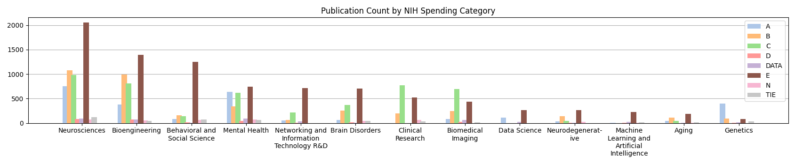
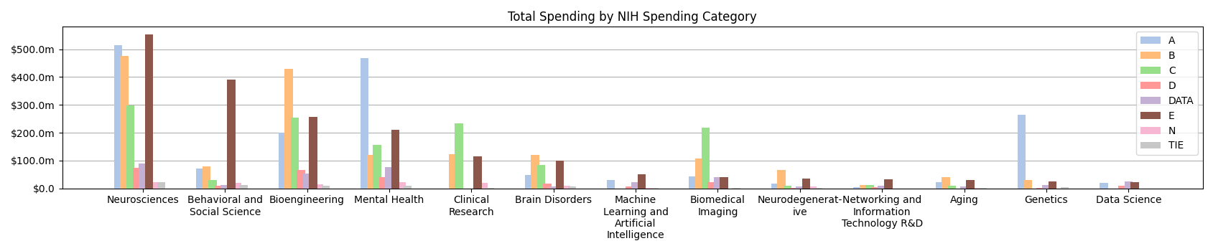
Team E Dominates in Publication Efficiency in all Domains
When comparing across a handful of the top spending categories in the BRAIN Initiative, Team E consistently contributes more funding and produces more publications in nearly every category.

Slide 47
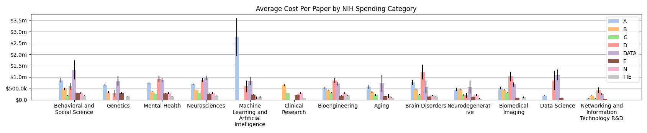
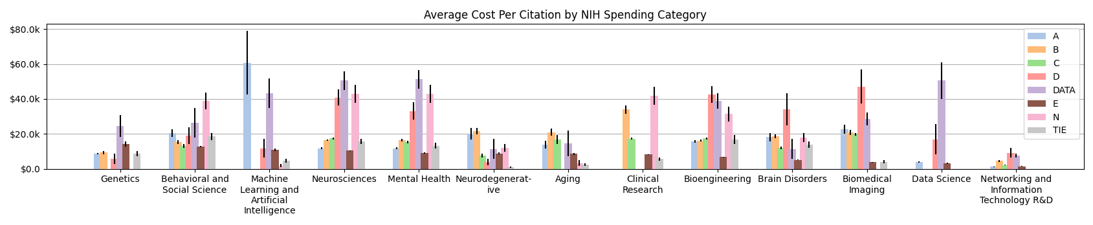
Team E Dominates in Publication Efficiency in all Domains
Despite leading in funding within the BRAIN Initiative, Team E still maintains one of the lowest cost-per-paper and cost-per-citation metrics across the board.

Slide 48
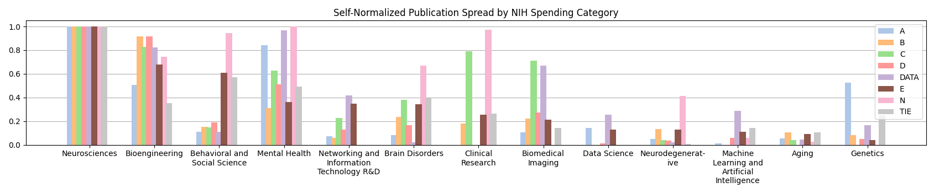
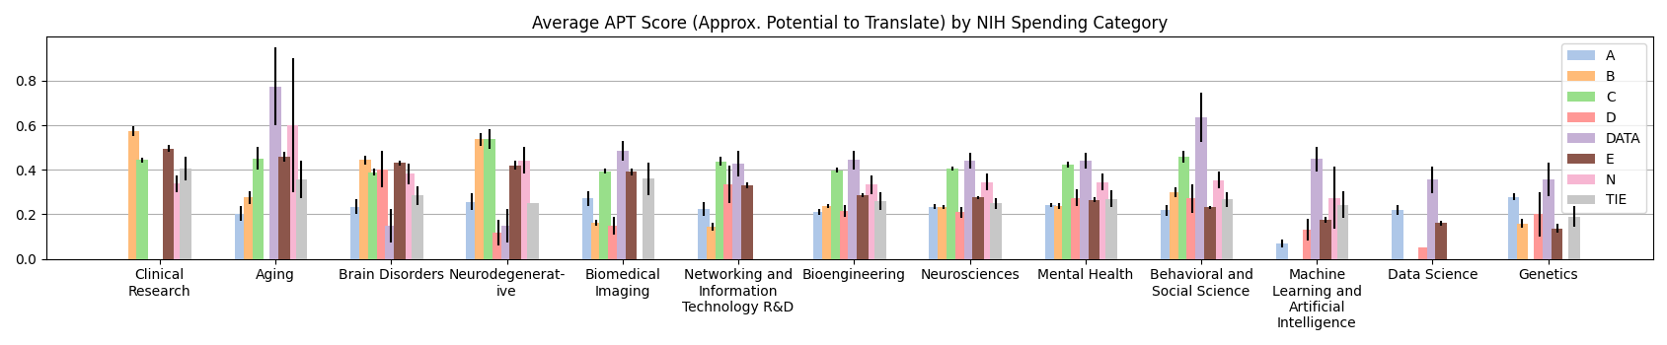
Team E Produces Variety
Team E maintained a relatively wider domain of publications while producing competitively applicable material.
Comparatively more consistent participation in most categories
Maintained high APT score in most categories

Slide 49
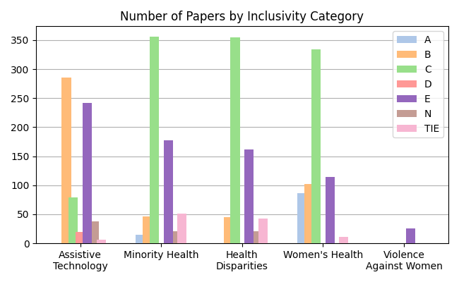
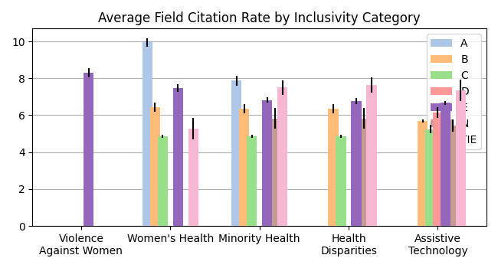
Team E Promotes Inclusivity
Team E provides a prominent supporting role in the BRAIN Initiative within domains regarding underrepresented demographics

Slide 50
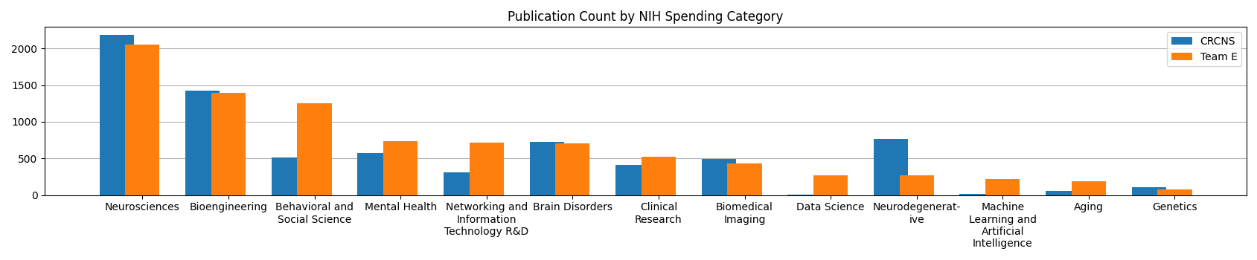
Team E Compared to Collaborative Research in Computational Neuroscience Awardees
CRCNS represents a comparable comparison in terms of publication numbers and domain distribution
When comparing Team E to the rest of the BRAIN Initiative, Team E has an advantage in terms of raw publication numbers. However, placed next to an equally effective portfolio of publications like that of the CRCNS, Team E still performs competitively across most metrics.
Here we can see that the spread of publication domains from the CRCNS compares more closely to that of Team E and thus provides a good comparison across other metrics. While there is significant overlap in the pool of publications for these two groups, this was accounted for in our analysis.

Slide 51
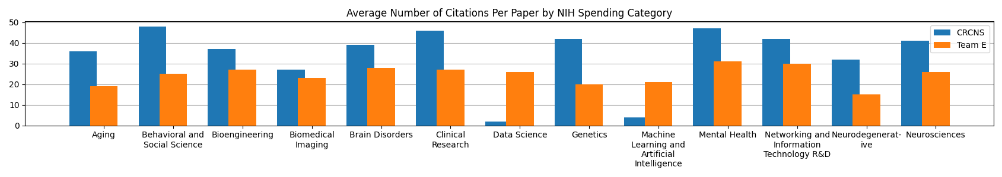
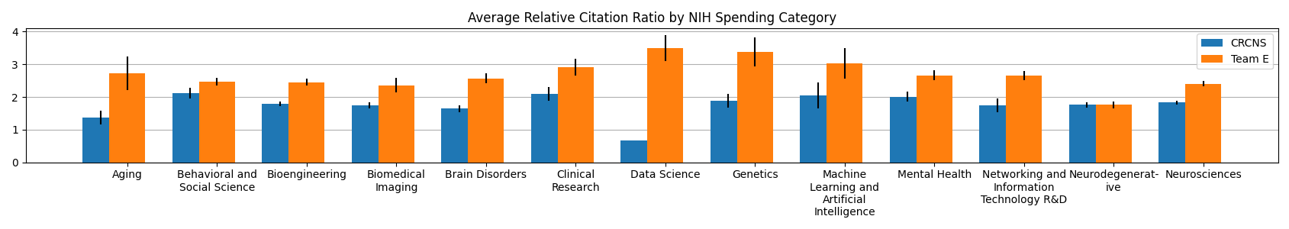
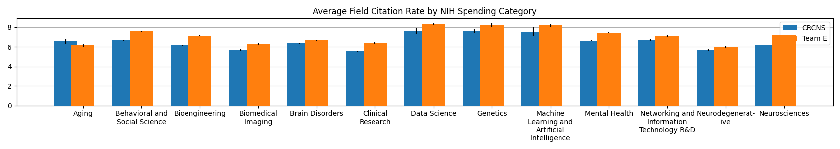
Team E Publications Have Higher Domain Applicability
Although CRCNS appears to outperform Team E in average citations/paper, we can see by the Relative Citation Ratio and Field Citation Rate that publications by Team E are consistently more applicable to their respective scientific domains.

Slide 52
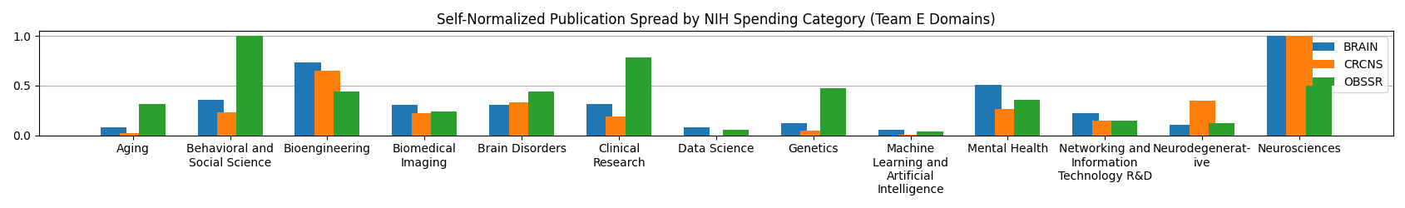
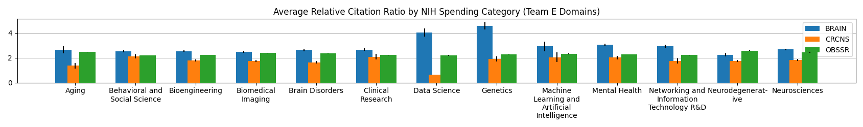
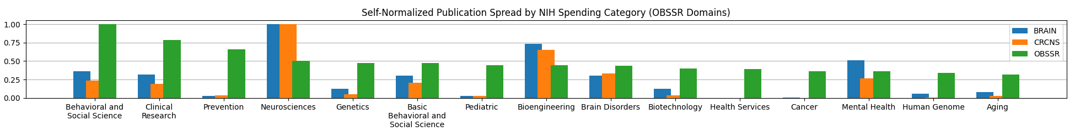
Additional OBSSR Comparison
As expected, the OBSSR focuses more heavily on Clinical Trials and Behavioral Research whereas the BRAIN Initiative and CRCNS excel in the domains of Neuroscience and Data Science.

Slide 53
Future Goals
Items we plan to accomplish by March 2023
Migration of Infrastructure
We plan to copy all infrastructural components developed over the last year into an AWS ecosystem within the NIH intranet.
Optimization of Algorithms
We plan to refine a model that predicts the current iteration of the novelty metric given a set of publication and author characteristics
Repository Rewrite
Continued work must be done to rewrite our codebase to facilitate releasing an open-source revision of the tool.

